Slide 1
INFO 5100 : Application Engineering and Development
Lab 1.5 : Implementing class relationships in Java

Slide 2
Objective
Show how to implement relationships between classes
Show how java works to connect and access objects
Show how to traverse relationships

Slide 4
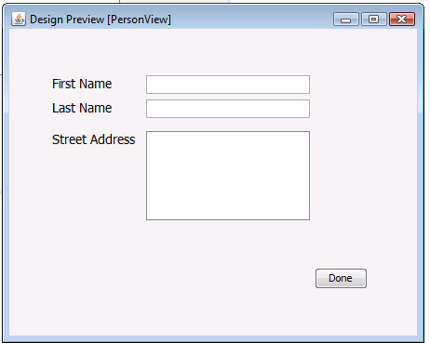
Person
FirstName
LastName
Address
Person is an object that is an instance of class Person. Must be created using the new operator

Slide 5
Data attributes are accessed through their interfaces
class Person {
Person
lastName: String
firstName: String
address: String
FirstName
LastName
Address
getLastName();
getFirstName();
getFullName();
getAddress();
setLastName()
setFirstName()
setAddress();
}

Slide 6
Form fields correspond to data attributes
class Person {
lastName: String
firstName: String
address: String
Person
getLastName();
getFirstName();
getFullName();
getAddress();
setLastName()
setFirstName()
setAddress();
}

Slide 7
Form fields have names
class Person {
lastName: String
firstName: String
address: String
Person
Field name is FirstNameTextField
getLastName();
getFirstName();
getFullName();
getAddress();
setLastName()
setFirstName()
setAddress();
}

Slide 8
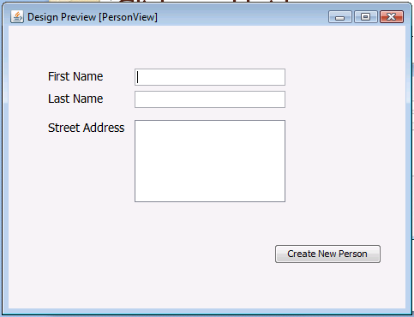
2
class Person {
Person person = new Person();
lastName: String
firstName: String
address: String
Person
getLastName();
getFirstName();
getFullName();
getAddress();
setLastName()
setFirstName()
setAddress();
}
1
FirstName
LastName
Address
Person p = new Person();
String fn = firstnameTextField.getText();
p.setFirstName(fn);
….
person

Slide 9
class Person {
3
lastName: String
firstName: String
address: String
Person
String fn = FirstNameTextField.getText();
getLastName();
getFirstName();
getFullName();
getAddress();
setLastName()
setFirstName()
setAddress();
}
FirstName
LastName
Address
Person p = new Person();
String fn = firstnameTextField.getText();
p.setFirstName(fn);
….
person

Slide 10
class Person {
3
lastName: String
firstName: String
address: String
Person
String fn = FirstNameTextField.getText();
getLastName();
getFirstName();
getFullName();
getAddress();
setLastName()
setFirstName()
setAddress();
}
person.setFirstName(fn);
4
FirstName
LastName
Address
Person p = new Person();
String fn = firstnameTextField.getText();
….
person

Slide 11
class Person {
lastName: String
firstName: String
address: String
Person
getLastName();
getFirstName();
getFullName();
getAddress();
setLastName()
setFirstName()
setAddress();
}
FirstName
LastName
Address
Person p = new Person();
String fn = firstnameTextField.getText();
p.setFirstName(fn);
….

Slide 12
The Business Model
Person
First name,
Last name,
Social security number
DOB
Address Line 1,
Address Line 2,
City
Country
Zipcode
Etc

Slide 13
Example: One person multiple addresses
Joe,
Smith,
290-29-2974
2/2/1986
360 Huntington Ave
Snell Engineering
Boston
MA
USA
02115
Etc….
Joe,
Smith,
290-29-2974
2/2/1986
100 Main Street,
Natick
MA
USA
01760
Etc….
Joe,
Smith,
290-29-2974
2/2/1986
201 Best street
Cool-town
Shanghai
China
Etc …..
Work Local home

Slide 14
Multiple addresses means duplication of information and potential for errors
Joe,
Smith,
290-29-2974
2/21/1990
360 Huntington Ave
Snell Engineering
Boston
MA
USA
02115
Etc….
Joe,
Smith,
200-29-2974
2/2/1986
100 Main Street,
Natick
MA
01760
USA
Etc….
Joe,
Summer,
290-29-2974
2/2/1986
201 Best Street
Cool-town
Shanghai
China
Etc …..
Work Local home

Slide 15
What if we split the info into:
First name,
Last name,
Social security number
DOB
Address Line 1,
Address Line 2,
City
Country
Zipcode

Slide 16
What if we split the info into:
First name,
Last name,
Social security number
DOB
Address
Address Line 1,
Address Line 2,
City
Country
Zipcode
Personal information
Address specific

Slide 17
What if we split the info into:
First name,
Last name,
Social security number
DOB
Address
Address Line 1,
Address Line 2,
City
Country
Zipcode
Person
Address

Slide 18
One person object linked to three address objects each keeping track of one address
Address I
Address 2
Address 3
Joe the
Person

Slide 19
A reference variable is needed in the person class to keep track of the address object
Person
address
Address
person
From the person perspective, we must add
An address attribute which will serve as a reference variable to the address object
getAddress method to retrieve the address object
setAddress method to store the address object as part of the person

Slide 20
But how do we differentiate different kinds of addresses from each other such as work, home,…?
Person
Address
Answer: we can’t with this kind of relationship unless we add an address type attribute to the address class

Slide 21
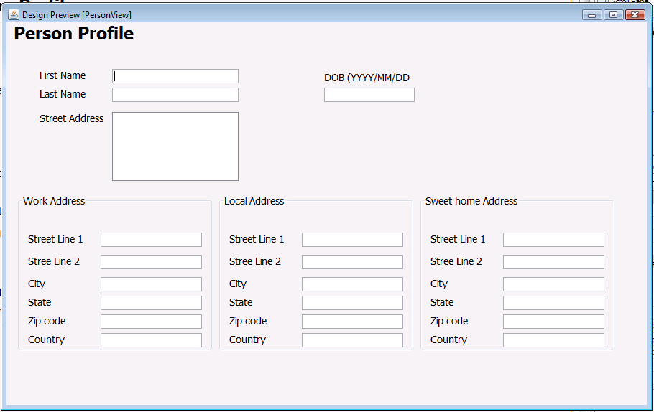
View Person Profile Screen
home address
Person
Work address
Address
local address

Slide 22
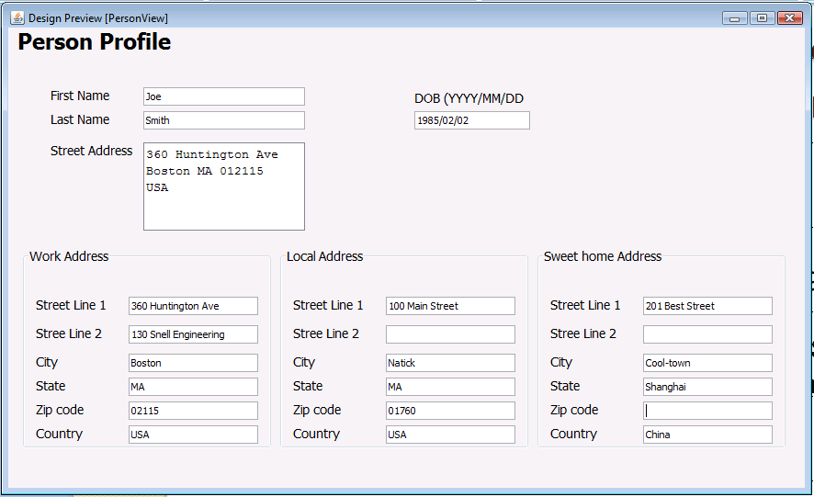

Slide 23
Matching the model to the user interface
Person
home address
Person
Work address
Address
Address
Address
Address
local address

Slide 24
home address
Person
Work address
Address

Slide 25
Changes are localized at the single address – person info remains fixed
home address
Person
Work address
Address
Display
local address
Home address
Work address
Local address
Update object from user

Slide 26
home address
Person
Work address
Address
local address

Slide 27
Class Person {
String lastName;
String firstName;
Address workaddress;
Address homeaddress;
Address localaddress;
public Address getWorkAddress(){
Return workaddress;
}
Public void setWorkAddress(Address addressparam){
Workaddress = addressparam;
}
:::
}

Slide 28
Class Person {
String lastName;
String firstName;
Address workaddress;
Address homeaddress;
Address localaddress;
public Address getWorkAddress(){
Return workaddress;
}
Public void setWorkAddress(Address addressparam){
Workaddress = addressparam;
}
:::
}
3 reference variables for keeping track of the 3 addressess

Slide 29
Implementation of the class Person
Class Person {
String lastName;
String firstName;
Address workaddress;
Address homeaddress;
Address localaddress;
public Address getWorkAddress(){
Return workaddress;
}
Public void setWorkAddress(Address addressparam){
Workaddress = addressparam;
}
:::
}
The reference variables hold addresses only. The must be declared of type Address

Slide 30
Class Person {
String lastName;
String firstName;
Address workaddress;
Address homeaddress;
Address localaddress;
public Address getWorkAddress(){
Return workaddress;
}
Public void setWorkAddress(Address addressparam){
Workaddress = addressparam;
}
:::
}

Slide 31
Implementation of the class Person
Class Person {
String lastName;
String firstName;
Address workaddress;
Address homeaddress;
Address localaddress;
public Address getWorkAddress(){
return workaddress;
}
Public void setWorkAddress(Address addressparam){
Workaddress = addressparam;
}
:::
}
The get method returns the workaddress object. The return value must be of type Address

Slide 32
Implementation of the class Person
Class Person {
String lastName;
String firstName;
Address workaddress;
Address homeaddress;
Address localaddress;
public Address getWorkAddress(){
Return workaddress;
}
Public void setWorkAddress(Address addressparam){
workaddress = addressparam;
}
:::
}
The set method returns nothing (void). It takes an address object as an input parameter and saves it in the workaddress attribute. As a result the person would be linked to an address object as the work address.

Slide 33
Implementation of the class Person
Person person = new Person();
person.setFirstName(“Joe”);
person.setLastName(“Smith”);
address address = new Address();
address.setAddressLine1(“360 Huntington Ave”);
person.setWorkAddress(address); //save address object as a work address
address = new Address(); // create new address object using the same ref variable
address.setAddressLine1(“100 Main Street”); //insert address info
person.setLocalAddress(address);
address = new Address();
address.setAddressLine1(“201 Best Street”);
Person.setHomeAddress(address);
//save address object as a local address

Slide 34
Consider the following form
Define a jframe with a jpanel similar to

Slide 35
Exercise
Define a project with a main class.
In the main method do the following:
Create a person object and three address objects. Initialize the objects with sample data.
Use the system.printlin function to print all your data in a format like the following:
Person
First name : Joe
Last name: Smith
Work Address
Address Line 1: 360 Huntington Ave.
Etc….

Slide 36
Exercise 2
Define a project with a jframe
In the constructor for the jframe initialize a person object and three address like before.
Pass the person object to a jpanel to display the person info as showing the form defined earlier.
In the constructor for the jpanel display the person and 3 addresses to the jpanel form.

